Slide 1
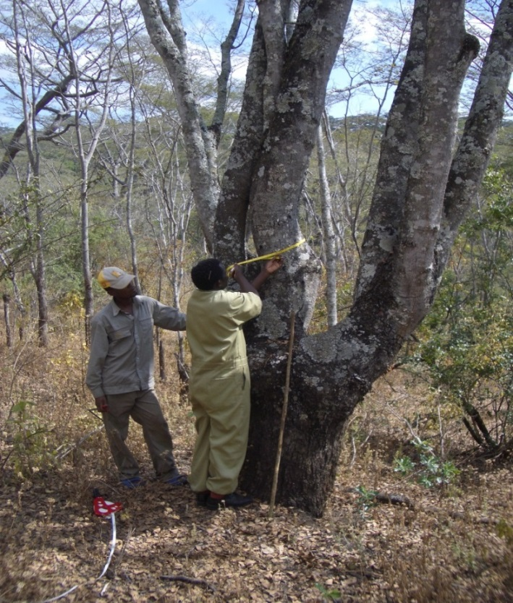
Module 2.4 Incorporating community-based monitoring (CBM) in national (or subnational/ jurisdictional)* REDD+ monitoring
Module developers:
Arturo Balderas Torres, Universidad Nacional Autónoma de Mexico
Margaret Skutsch, Universidad Nacional Autónoma de Mexico
After the course, participants should be able to:
Present arguments for the benefits of CBM as an element within national REDD+ monitoring
Explain the steps needed to set up CBM as an element within national REDD+ monitoring
* Advice presented here applies equally to the cases of national and subnational/jurisdictional REDD+ monitoring.
V1, May 2015
Creative Commons License
Notes:
The objective of this module is to present to the participants a general review of the options for integrating CBM into national monitoring systems for REDD+.
The information presented includes reference to texts adopted under the UNFCCC and a general description of methods available for CBM.
At the end of the course it is expected that the participants will be able to present arguments for the benefits of the inclusion of CBM as an element within national REDD+ monitoring.
Participants should be able to explain the general steps needed to set up CBM in their countries as an element within national REDD+ monitoring systems.
While most of the discussion presented in this module is focused on national monitoring systems and national measuring, reporting, and verification (MRV) for REDD+, the implications can be extended to subnational or jurisdictional REDD+ projects and their corresponding monitoring systems.
Photo credit for this slide: Jeroen Verplanke, Kyoto Think Global Act Local project.

Slide 2
Background material
GOFC-GOLD. 2014. Sourcebook. Section 3.4.
IPCC (International Panel on Climate Change). 2003. Good Practice Guidance for Land Use, Land-Use Change and Forestry.
Skutsch, M. 2011. Community Forest Monitoring for the Carbon Market: Opportunities under REDD+.
Danielsen et al. 2013. “Community Monitoring for REDD+: International Promises and Field Realities. Ecology and Society.
FCPF (Forest Carbon Partnership Facility). 2011. “Linking Community Monitoring to National Measurement, Reporting, and Verification for REDD+.” Report on an FCPF workshop.
Notes:
This list provides examples of relevant information that can be reviewed to get a general context of CBM and its role within REDD+.

Slide 3
Background material
Balderas Torres, A. 2014. Potential for Integrating Community Based Monitoring into REDD+. Forests.
Balderas Torres, A. 2013. Opportunities and challenges for integrating CBM into MRV systems for REDD+ in Mexico. The Nature Conservancy. Consultancy Report, Mexico, D.F. Available online
Danielsen et al. 2011. “At the Heart of REDD+: A Role for Local People in Monitoring Forests?” Conservation Letters.
McDicken, K. 1997. A Guide to Monitoring Carbon Storage in Forestry and Agroforestry Projects.
UNFCCC COP (United Nations Framework Convention on Climate Change Conference of the Parties). 2010. Report of the Conference of Parties on Its 15th Session, Held in Copenhagen from 7–19 December 2009.

Slide 4
Outline of the lecture
Why CBM should be part of national monitoring for REDD+
How CBM can relate to the national forest monitoring system (NFMS) and national monitoring
Setting up protocols for CBM
Monitoring other (noncarbon) variables
How to feed local data into a national database
Other issues: Verification and the basis of benefit sharing
How much does CBM cost?
Planning a national CBM monitoring exercise
Notes:
In addition to these elements, there are exercises and country examples in different presentations.

Slide 5
Outline of the lecture
Why CBM should be part of national monitoring for REDD+
How CBM can relate to the national forest monitoring system (NFMS) and national monitoring
Setting up protocols for CBM
Monitoring other (noncarbon) variables
How to feed local data into a national database
Other issues: verification and the basis of benefit sharing
How much does CBM cost?
Planning a national CBM monitoring exercise

Slide 6
Role of communities in national monitoring for REDD+ (1/2)
Monitoring systems for REDD+ include many activities related to design, planning, data gathering, processing, report, and verification of the information.
Community-based monitoring (CBM) refers to those monitoring systems where communities play an active role in one or more of these activities depending on the design or the scheme, local skills, resources, and capabilities.
Usually communities play a more active role in data gathering at local level.

Slide 7
Role of communities in national monitoring for REDD+ (2/2)
Countries have been requested to create national forest monitoring systems.
Data requirements include levels and changes of forested area and carbon stocks (geographical/activity data and carbon stock change factors).
Data is required for construction of the national forest reference emission levels (FRELs) and forest reference levels (FRLs).
A phased approach starting with relatively low accuracy data (Tier 1) migration toward advanced levels (Tier 3) could be greatly increased by CBM.
Notes:
There is a need to include CBM as part of the monitoring systems for REDD+.
Countries have been requested by the Conference of the Parties under the UNFCC, to create national forest monitoring systems as part or REDD+. Essentially these systems require information of forest area and changes in forest area and the associated carbon stocks and stock changes. Much of the data to be included in these systems will come from remote sensing, but ground-level data will be essential not only for calibrating remotely sensed data but also for assessing change which cannot easily be measured using satellite images, particularly rates of degradation and of forest enhancement.
In the first instance, estimates of carbon emissions and removals as part of national systems may be done using data of relatively low accuracy (Tier 1), but over time the specificity of these estimates and of the baselines could be greatly increased by the availability of local level Tier 3 information that can be potentially be produced through CBM.

Slide 8
Community engagement in REDD+ monitoring (1/2)
The UNFCCC COP recognized that implementation of REDD+ requires full engagement of indigenous groups and local communities, and monitoring could be a good way to promote participation (UNFCCC COP 2010).
Countries have different starting points in terms of data availability.
Where communities are engaged in managing forests, such data could be gathered more easily.
Notes:
Most countries do not have adequate data from national forest inventories for this, but where communities are engaged in managing forests, such data could be gathered.

Slide 9
Community engagement in REDD+ monitoring (2/2)
Phased approach to monitoring for REDD+ (see Module 1.1):
Emissions Factors: Tier 1 → Tier 2 → Tier 3 (local data, carbon content/dynamics) (see Module 2.3)
Activity/Geographical Data: Approach 1 → 2 → 3 (frequent, descriptive information of land uses and land-use changes, with high resolution) (see Module 2.1)
CBM offers the opportunity to provide Tier 3, Approach 3 data, although only in the areas where communities are actively engaged in forest management and/or REDD+ activities.
Identification of managed areas as new stratum, to help explain the variability of carbon stocks and changes and to reduce uncertainties in estimates
Notes:
REDD+ and the NFMS and MRV systems will be implemented in a phased approach.
CBM offers the opportunity to provide more detailed information—Tier 3, Approach 3 data—although only in the areas where communities are actively engaged in forest management and/or REDD+ activities.
One important potential contribution of CBM is the addition of the type of management as a new variable for the classification of forests and estimation of carbon emissions and removals. Typically, NFMS classifies land and forests according to land-use type or vegetation cover but is unable to identify different management practices. CBM can provide this information since communities can identify and map polygons of forest under different types of management. These particularities can help in explaining the variability of carbon content, emissions, and removals in forests and reduce the uncertainty of information in REDD+.

Slide 10
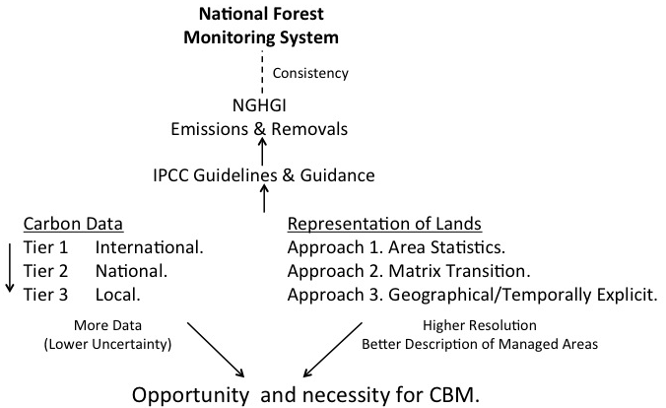
Opportunity for CBM within phased approach for building NFMSs
Source: Balderas Torres (2013)
Notes:
The decisions adopted at the COP indicate that the NFMSs should be consistent with the methods and estimates of emissions and removals of the national inventories of greenhouse gas (GHG) emissions and removals. These inventories are submitted periodically by countries to the UNFCCC and are based on the methodologies published by the IPCC. In the case of the chapters on “Land Use, Land-Use Change and Forestry” (IPCC, 2003, GPG LULUCF) or the “Agriculture, Forestry and Other Land Uses” (IPCC, 2006, AFOLU GL), the two main sources of information correspond to that of carbon stocks and stock changes and geographical information on the areas that are under different land uses; this second group of information is also called activity data (AD). The phased approach indicates that monitoring systems should move toward the generation of Tier 3 local data for carbon stocks and geographically explicit information on forest areas with high resolution and frequent updates. An appropriate CBM program could contribute to the generation of these two types of information.
Note: NGHGI = National Greenhouse Gas Inventories.

Slide 11
Advantages of CBM
Accurate measurements
Enables frequent update of data
Low-cost data gathering
Access to remote areas
Multifunctional
Transparent
Improves decision making
Notes:
These are some of the advantages of CBM in the monitoring of natural resources and forests:
Accurate measurements. It has been shown that CBM can be as reliable as professional measurements.
CBM has the potential to produce frequent update of data (e.g., annual surveys of forest stock and areas of forest and to report changes).
Low cost-data gathering: however, it is important to mention that initial training and equipment are required.
CBM can provide access to remote areas, as long as communities are actively engaged in forest management in these areas. Among other things, this can reduce the cost of transport of external professional brigades for monitoring.
CBM can be multifunctional since it can be combined with monitoring of other environmental services/forest products that are locally relevant.
Information produced through CBM can give transparency to benefit sharing mechanisms.
Finally, data produced through CBM can help local decision making since communities that monitor tend also to manage their forests better.

Slide 12
Initial challenges for including CBM into national monitoring systems for REDD+
Consistency of methods with IPCC guidelines, National Greenhouse Gas Inventory (NGHGI) and the FREL/FRL submitted to UNFCCC for REDD+.
Consistent use of definitions of forest.
Data should be consistent across communities producing data through CBM (variables, methods, and formats).
Standardized protocols are required.
Notes:
However, there are some challenges that need to be addressed if CBM is to be used as part of national forest carbon monitoring for REDD+:
It would have to provide data that is in a form consistent with IPCC guidelines and with the National Greenhouse Gas Inventory (NGHGI), as well as with the baselines that the country submits to UNFCCC for REDD+.
It would have to use definitions of forest consistent with these systems.
It would have to use methodologies acceptable to and recommended by IPCC.
For consistency of CBM data and use in the NFMS, all communities would have to present the same kinds of data in the same formats.
All these implies that standard protocols would have to be used.

Slide 13
Outline of the lecture
Why CBM should be part of national monitoring for REDD+
How CBM can relate to the national forest monitoring system (NFMS) and national monitoring
Setting up protocols for CBM
Monitoring other (noncarbon) variables
How to feed local data into a national database
Other issues: verification and the basis of benefit sharing
How much does CBM cost?
Planning a national CBM monitoring exercise

Slide 14
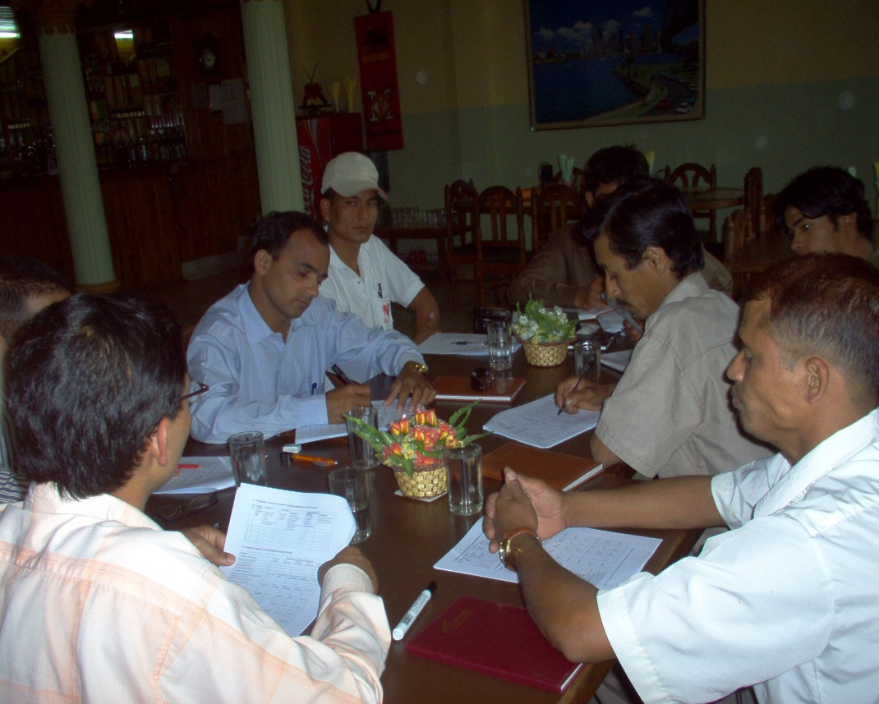
Integrating CBM into national measuring, reporting, and verification (MRV) and NFMS
Assumption:
National REDD+ program is implementing a top-down approach based on interpretation of satellite imagery and Tier 1 and possible Tier 2 carbon data (national forest inventories).
Notes:
Photo credit: Bhaskar Karky, Kyoto Think Global Act Local Project.

Slide 15
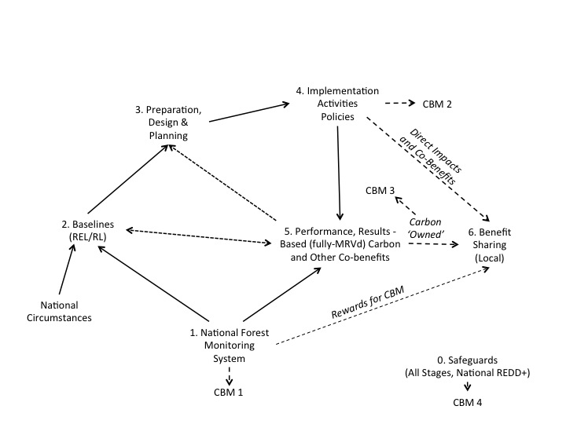
Main opportunities for integrating CBM into national MRV and NFMS
Source: Balderas Torres (2014)
Notes:
Based on the decisions adopted at the COP, the diagram shows the different elements expected in REDD+. Initial estimates of carbon emissions and removals are to be prepared. These should be consistent with the national inventories on GHG emissions and removals and the guidelines published by IPCC (step 1). This historical information along with the consideration of national circumstances will be used to set the baselines for REDD+, which will be used to evaluate performance on a carbon basis (step 2). Steps 3 to 5 show the phased implementation of REDD+ starting in the preparation stage, the implementation of initial activities, and then the full implementation of REDD+, where activities will be fully monitored, reported, and verified. Performance will be assessed against the baseline using the information that will be integrated periodically into the national monitoring systems. New baselines will be established for subsequent periods and implementation will continue. Depending on the results of implementation against the baselines it may be possible to access to performance-based finance, in which case the country should have in place a system for benefit sharing (step 6). In all the stages of implementation the countries should implement the social and environmental safeguards of REDD+ (step 0).
In this context is possible to identify four general and different types of monitoring activities were CBM could be included. The first is related to the addition of data to the national systems (CBM 1). The second would be information already produced by communities as part of regular forest management (CBM 2). The third is the information produced as part of the participation in carbon markets and other certification schemes (CBM 3). The fourth would be the information related to the implementation of safeguards (CBM 4). For more details on CBM 1, CBM 2, CBM 3, and CBM 4, see next slides.

Slide 16
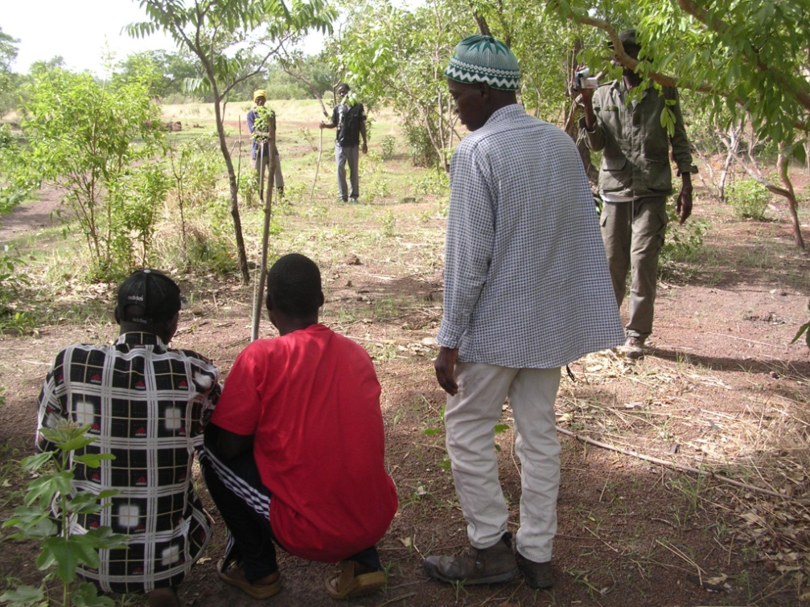
Opportunity 1. Data gathering in public programs
Activities developed to increase sample size of forest inventories:
Community brigades
As part of existing programs (PES, conservation, CFM, etc.)
Main benefit: wages for brigades, access to public programs.
Easier to align protocols to national systems.
Notes:
PES = payment for environmental services
CFM = community forest management
Photo credit: Libasse Ba, Kyoto Think Global Act Local Project.

Slide 17
Opportunity 2. Activities driven by local access to benefits and co-benefits
Access to local, direct benefits motivates CBM (e.g., water supply, timber, and nontimber forest products).
There is a need to align protocols to national systems.
Agreements over data ownership are needed.
It is necessary to ensure management practices have positive impacts on carbon.

Slide 18
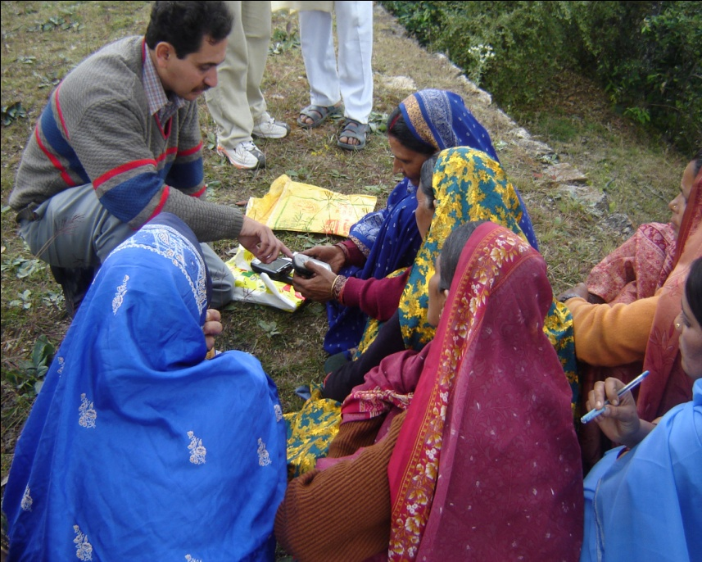
Opportunity 3. Information from projects in carbon markets and certification schemes
Projects participating in carbon markets or schemes such as Fair Trade, Organic, and FSC can provide data for MRV systems.
There can be benefits for local people from carbon credits and premiums for certified products.
Notes:
Photo credit: Pushkin Phartiyal, Kyoto Think Global Act Local Project.

Slide 19
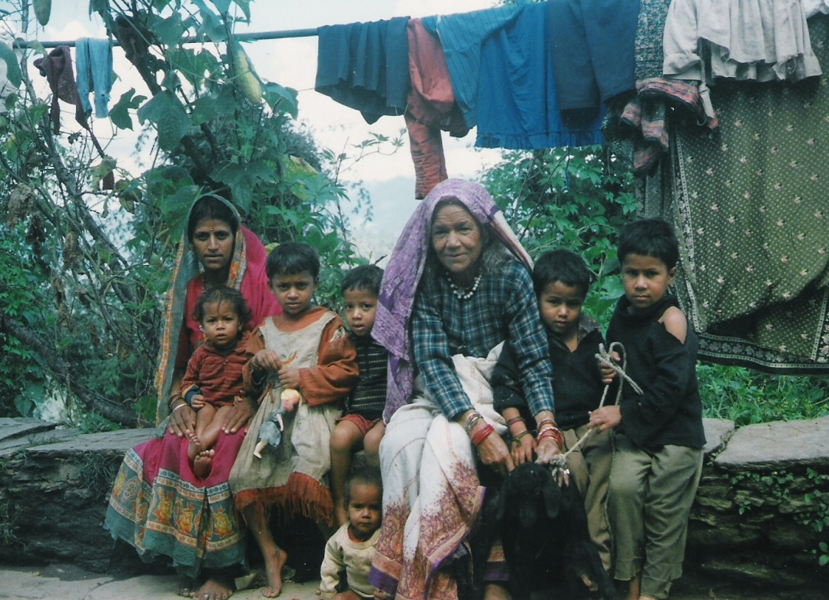
Opportunity 4. Implementation of safeguards
There is a need to document implementation of safeguards.
These activities may not be linked to forest inventories, but documentation can provide geographical data of regions participating actively in REDD+.
Notes:
Photo credit: Pushkin Phartiyal, Kyoto Think Global Act Local Project.

Slide 20
Discussion 1
Which of the four opportunities for CBM that have been identified do you think would be most useful in the case of your own country? Consider the following:
Are there public schemes targeting community forest management/conservation practices?
Are there CFM practices in which implementation is driven by communities? Are communities interested in the local provision of specific environmental services?
Are communities participating in carbon markets or other certification schemes?
Are communities actively participating in REDD+ implementation? How can participation be documented?
Notes:
This slide and the next slide introduce points that can be discussed with the course participants.

Slide 21
Discussion 2
CBM can be carried out only in areas where communities are actively engaged in community forest management and/or REDD+ activities:
How much of the country could be monitored in this way? Would the data be useful if it is patchy?
Could and should CBM be made compulsory, as a condition for participating in REDD+?
Should people be paid to do it (separately from any funds disbursed for forest management itself or for carbon performance)?

Slide 22
Outline of the lecture
Why CBM should be part of national monitoring for REDD+
How CBM can relate to the national forest monitoring system (NFMS) and national monitoring
Setting up protocols for CBM
Monitoring other (noncarbon) variables
How to feed local data into a national database
Other issues: verification and the basis of benefit sharing
How much does CBM cost?
Planning a national CBM monitoring exercise

Slide 23
Standardized protocols for CBM
Data should be compatible with NFMS.
It is necessary that data facilitate comparisons and evaluation among different REDD+ interventions.
Standardized protocols (i.e., variables and methods) are needed.
Methods needed for stock and stock-changes in permanent plots (stock-difference method).
Statistics of management practices can also provide information to assess emissions and removals (gain-and-loss method).
Methods can be selected ad hoc according to local context.
This data can add to that of national inventories to increase sample size.
Notes:
In order to achieve data compatible with NFMS and to be able to make comparisons easier between different REDD+ interventions, you need to define and prepare protocols (variables and methods). Choices may be different between different countries and need to be made carefully, on the basis of need and opportunities available.
Protocols enable communities to measure the stock and stock changes and by taking sample measurements at fixed and predetermined places in the forest at a given point in time.
When using the stock-difference method, repeated measurements will thus show changes (increase and decreases) in density of carbon over time.
One contribution of CBM would be the increase in the number of measurement plots, or sample size of the forest inventories, when this information is put together with national or regional inventories.

Slide 24
Functions of CBM in national monitoring
Forest area and area changes (monitoring of deforestation) are difficult for CBM to monitor → most likely through remote sensing.
Primary aim of a CBM survey is to measure carbon stocks and changes in carbon stock in community forests.
CBM can also provide geographical information of forest areas under management (i.e., participatory mapping),
New areas of afforestation may also be included.
CBM allows accurate identification of forest trajectories and supports the analysis of drivers of emissions.
Notes:
Methods usually involve measurement of diameter at breast height of the trees using a tape or calipers and of tree height using a clinometer, in predetermined sampling plots, although other possibilities are available (refer to community manual provided).
It is unlikely that CBM at ground level will deliver good data on change in forest area (i.e., deforestation), for which remote sensing is a much better option (and interpretation of satellite images is not, in general, a task within the capabilities of most communities). CBM can provide information of forest areas under management and specific details and accurate trajectories of forests.
In other words the primary aim of a CBM survey is to measure carbon stocks and changes in carbon stock in community forests that remain as forests over time. New areas of afforestation may also be included. This information can provide great aid in understanding the drivers of deforestation and forest degradation.

Slide 25
General approaches to set up protocols (1)
Methods to estimate carbon stocks:
Set up a forest inventory and collect data of individual trees via DBH (caliper/tape) and height (clinometer) and later use of allometric equations to estimate biomass See manual provided for this course, or any of those listed following:
Wood Hole Research Institute: http://www.whrc.org/resources/fieldguides/carbon/pdf/chapter6.pdf.
The KTGAL project: http://www.communitycarbonforestry.org/. The link is under Resources, Community Monitoring.
The Nepal-based network ANSAB: http://www.ansab.org/wp-content/uploads/2010/08/Carbon-Measurement-Guideline-REDD-final.pdf.
UN REDD Vietnam: http://www.un.org.vn/en/component/docman/cat_view/130-un-viet-nam-joint-publications/209-climate-change-joint-un-publications.html?orderby=dmdate_published.
Winrock International: http://202.99.63.183/tanhui/thjl/Winrock%20International%20%E7%A2%B3%E7%9B%91%E6%B5%8B%E6%8C%87%E5%8D%97.pdf.
Notes:
Estimates of carbon stock within the forest can be made in three fundamentally different ways:
By measuring the dimensions of trees (DBH, height) in fixed, permanent sampling plots and later applying allometric equations to this data to obtain an estimate of biomass (equipment: tape/calipers and clinometers) (refer to community manual provided).
By using a relascope that estimates basal area, in fixed, permanent sampling plots and then using modified allometric equations to estimate biomass. To this, estimates of canopy cover could be added, using a densiometer or fisheye camera and indices of leaf area index.
By proxy, without direct measurements, but quantifying the difference between estimated rate of off-take and rate of natural growth (using the gain-Loss method). This can be done only if there is a clear understanding of what is causing loss of forest biomass and if there are reliable statistics both on the extraction rates and on the biological growth rates of trees (the normal mean annual increment of the forest).

Slide 26
General approaches to set up protocols (2)
Set up measurement plots to determine basal area visually (relascope) and apply modified allometric equations to estimate biomass
Obtain figures of volume of timber and apply biomass expansion factors (visually or remotely, i.e., drones and/or LiDAR)
Methods to estimate changes in carbon stocks:
Take repetitive measurements of stocks in plots
Quantify reductions and increments of biomass and carbon in forests in a given period (gain-loss method); understand management practices and dynamics of carbon in the forest; have access to associated statistics and censuses
Notes:
LiDAR = LIght Detection And Ranging technology which uses active sensors, See module 2.8

Slide 27
Processes Leading to losses/reductions and gains/increments in the different carbon pools
Source: Balderas Torres (2013)
Notes:
This table identifies the different processes that could result in the loss or reduction or the increment of carbon stocks in forests. These are the types of processes that should be understood and documented if gain-loss methods are to be considered as part of CBM.

Slide 28
Discussion 3
Under what circumstances would you recommend using the gain-loss method instead of stock change estimation, and why?
Relascopes are generally used in the timber industry and often in plantation forests where the variation between sizes of trees is relatively small:
Do any of the participants have experience in their use?
Would the relascope pick up differences in woody biomass if used, say, in annual surveys of savanna forests (miombo, selva baja, cerrado, etc.)?
Notes:
Different terms are used in different parts of the world for savanna forests: miombo in East Africa, selva baja in Central America, and Cerrado in northern Brazil, for example.

Slide 29
Advantages and disadvantages of different approaches
Stock-difference, gain-loss, visual methods, LiDAR:
Variables to measure
Cost of equipment
Capacities and technical skills required
Maintenance and calibration
Steps required for data analysis

Slide 30
Acceptable error level
Need to select the level of error that is acceptable in estimating the mean carbon stock.
Acceptable level of error is usually 10% or 5%.
The value selected will affect the number of sampling plots that are required.

Slide 31
Advantages and disadvantages of different confidence levels
A lower level of error means that the mean value of the estimate of carbon is more likely to be correct.
However, this requires many more sampling plots.
Hence there is a trade-off in terms of the need for accurate data and the costs involved in achieving it.
The levels of error to be used may be set by companies or organizations buying carbon credits or financing REDD+ activities.

Slide 32
Sampling
The size and shape (circular or rectangular) of sampling plots needs to be selected:
Circular plots are easier for communities to lay out
In open forests where the number of tree stems per hectare is low, larger sampling plots will be needed than in dense forests.
It is common practice to use nested plots in which a small plot is defined within the larger one:
In this case, all trees above a given diameter at breast height (e.g., DBH >10cm) are measured in the large plot, but smaller trees (say, 2.5–10 cm diameter) are measured only in the smaller, inner plot

Slide 33
Typical plot sizes for forest inventories
Vegetation characteristics | Plot radius (m) | Plot size (m²)
Very dense vegetation, stands with large numbers of small stems, or highly uniform distribution of larger stems (e.g., even aged plantations) | 5.64 | 100.0
Moderately dense woody vegetation | 8.92 | 250.0
Moderately sparse woody vegetation | 12.62 | 500.0
Sparse woody vegetation | 14.56 | 666.6
Very sparse woody vegetation | 17.84 | 1000.0
Source: MacDicken 1997.
Notes:
This table presents the typical size of monitoring plots depending on the condition of vegetation. In denser forests, the size of the plots can be smaller, since these sites will be able to capture the variability of carbon stocks. Larger sites are needed where the vegetation is more disperse, since smaller plots may produce nonrepresentative values.

Slide 34
Scope: Carbon pools
Possible pools to be measured:
Aboveground tree biomass
Belowground tree biomass (roots)
Soil carbon
Shrub layer (bushes, etc.)
Litter layer (leaves)
Deadwood (fallen branches, etc.)
When should a pool be included?
If it is expected to change (increase) due to the REDD+ management practices introduced
Or alternatively if it is likely to be negatively affected
Notes:
When should a pool (reservoir) be included? Since monitoring is expensive, it is only worth including a reservoir if it is expected to change (increase) due to the REDD+ management practices introduced, or alternatively if it is likely to be negatively affected. If neither of these is likely, it can be considered a stable reservoir and not a source of emissions; hence it does not need to measured. Typical processes affecting the different pools is given in the table on slide 27.

Slide 35
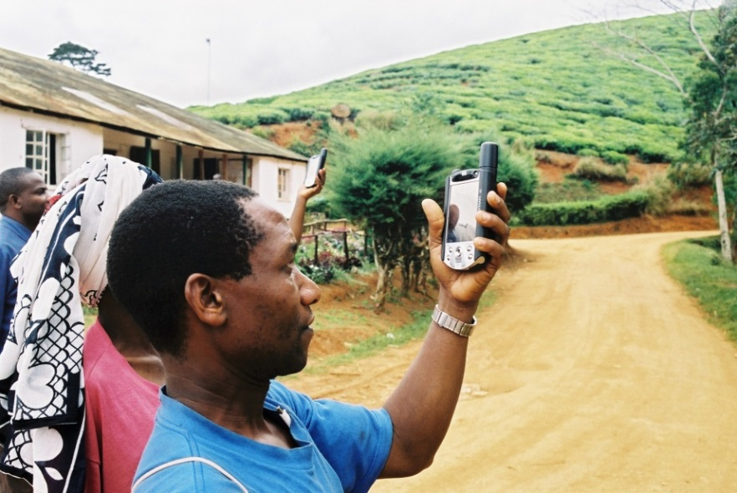
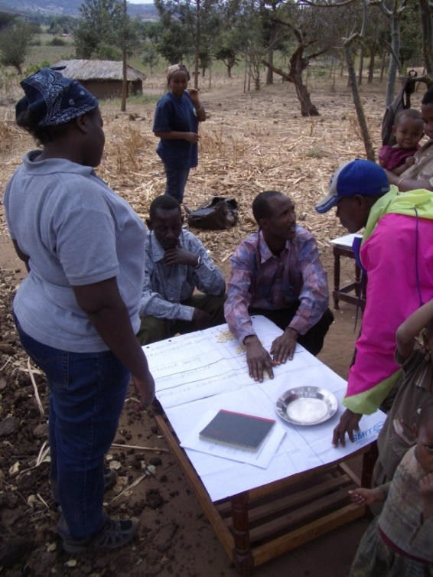
Equipment and technology
The data recording technology to be used:
Paper based data collection or electronic?
Tailor made apps for smartphones or tablets for CBC (mostly freeware)
If electronic, which of the different systems available would be most suitable?
Notes:
Photo credit: Jeroen Verplanke, Kyoto Think Global Act Local Project.

Slide 36
Skills required for different technologies as part of CBM (Larrazabal and McCall, forthcoming)
Notes:
There are many new technological developments and equipment that can be included as part of CBM schemes. A crucial question is whether CBM would benefit from the use of electronic equipment or not. There is some considerable experience with handheld electronic systems of various kinds using different types of software. A question is what skills community people would require for using the different systems that are available. This table reviews this question.
The table indicates that communities may easily use electronic equipment in the field to register data, provided the machines are programmed in advance. Moreover, even illiteracy is not a barrier to its use in this sense.
Many of the software programs use icons, and at most numeracy is required. It is easier to use the GPS function built into handheld computers for data recording, than to use an independent GPS instrument combined with a paper system for data recording. However, processing the data (downloading it and entering it into other programs) requires a relatively high level of computer skill that may not be present in the communities. The design of an electronic protocol of its own choice would also be a task beyond the capacity of most communities. This means that in general, technical supports (e.g., from environmental NGOs, consultants, and other intermediary organizations) would be necessary for programming and for data analysis, and this same support would need to be used during training.

Slide 37
Advantages of electronic recording of data
User-friendly interfaces on smartphones and tablets make entry of data quick and easy.
Less risk of errors in transmission if the data is entered into the database at the time of measurement.
Less time spent on coding and analyzing data after the fieldwork is finished.
The GPS coordinates of the plot can be automatically registered and associated with the data.
Photographs can be taken using the same equipment and directly associated with the biomass data in the database.

Slide 38
Disadvantages of electronic recording of data
Equipment (smartphones, tablets) may not be available.
Battery life can be a problem:
Back up batteries or solar chargers can be a solution
In some conditions (dense forest, deep valleys) GPS signals may not be easy to obtain.
Training is obviously necessary, but can be easily done for a selected software system
Notes:
Increasingly, smartphones can be found at community level in most countries.

Slide 39
Discussion 4
What is the availability of smartphones in rural communities in your country?
The alternative is for the community to use paper recording formats: the supervising organization/NGO transcribes the data into the database on a PC or laptop. Which system do you consider to be more reliable?

Slide 40
Frequency of measurements
Monitoring takes time and is costly to the community.
Frequency should be established depending on changes in management practices and expected growth rates (detectable changes).
However, the more frequent the measurements, the greater the reliability of the data; trends can be more easily seen and errors caught and corrected.
Consider the need for retraining for infrequent measurements.
Notes:
Monitoring takes time and can be a burden to the community.
However, the more frequent the measurements, the greater the reliability of the data; trends can be more easily seen and errors caught and corrected.
If measurements are made annually, the team trained to do this is unlikely to forget the procedures. If the measuring is done less than once in two years, the members may need retraining.
It is very important to consider the expected growth rate of the forest, in areas where trees grow slowly (e.g., dry forests) it may be necessary to wait for five years or more before taking the second measurement, as otherwise changes might not be measured.

Slide 41
Outline of the lecture
Why CBM should be part of national monitoring for REDD+
How CBM can relate to the national forest monitoring system (NFMS) and national monitoring
Setting up protocols for CBM
Monitoring other (noncarbon) variables
How to feed local data into a national database
Other issues: verification and the basis of benefit sharing
How much does CBM cost?
Planning a national CBM monitoring exercise

Slide 42
Monitoring other (noncarbon) variables
REDD+ projects can deliver benefits additional to emissions reductions:
Biodiversity conservation, enhanced forest governance, water services, etc.
There is a possibility of using electronic system to record data relating to safeguards.
A need exists to establish a protocol and appropriate methodologies for monitoring specific noncarbon benefits.
Discussion:
Do you think that standard protocols are possible for safeguards, or are they too different in different areas to allow this? What elements should be included?

Slide 43
Monitoring drivers of deforestation and forest degradation
Monitoring changes in drivers could help to anticipate changes in emissions and removals.
Changes are related to management practices inside and outside forests (e.g., silvicultural activities, protective activities, changes in agricultural practices, efficient stoves, etc.).
Communities could identify drivers and document key indicators.
Understanding the impact of changes in drivers is very important for evaluating approaches to dealing with deforestation and degradation.
Notes:
In many cases it may be more important to measure the changes in drivers rather than the changes in carbon stocks themselves. These could relate to the activities carried out in the forests themselves (silvicultural activities, protective activities) or they could be outside the forest (changes in behavior in agriculture, use of fuel efficient stoves etc.).
It would be possible for communities to monitor key indicators but these would have to be clearly defined, and could vary greatly between different areas.
Understanding the impact of changes in drivers is very important for evaluating approaches to dealing with deforestation and degradation.

Slide 44
Outline of the lecture
Why CBM should be part of national monitoring for REDD+
How CBM can relate to the national forest monitoring system (NFMS) and national monitoring
Setting up protocols for CBM
Monitoring other (noncarbon) variables
How to feed local data into a national database
Other issues: verification and the basis of benefit sharing
How much does CBM cost?
Planning a national CBM monitoring exercise

Slide 45
Integrating local data into a national database
Protocols will have to ensure CBM data is compatible with NFMS.
CBM can densify existing inventories.
CBM can add a new layer to estimate carbon stocks and changes in managed areas:
It has the potential to evaluate the impact of different management practices
It is possible to design participatory systems (direct upload of data by communities).
Data ownership and protection need to be considered.
Notes:
If data from CBM are to be fed into the NFMS, the protocols will have to ensure that the data are compatible with that in the NFMS.
A separate layer would be required in the NFMS to integrate this data, which has a much higher spatial resolution than standard data in NFMS. CBM-generated data would serve to densify/corroborate data from points that are more widely spread in the national system (moving estimates from Tier 1 or 2 to Tier 3 for the areas covered).
In principle, data could be uploaded by communities or their support organizations, but filters would be needed for checking data quality (unusually high or low values would have to be inspected manually).
Data would have to be protected—communities may be unwilling to participate if they are afraid their data may be misused.
If data on the type of local management are included, the database could be used for national level analysis of the impacts of different types of management on carbon stocks and stock change over time.

Slide 46
Example of integration of local data (1)
National systems can become participatory to allow the integration of local geographical and carbon data.
Example: In a national system a region is classified as Tropical and Oak Forest
But one subarea could be under improved forest management by a community, (blue)
A community can provide local data on the managed area
Based in Balderas Torres (2013)
Notes:
The following slides presents an example of how data produced through CBM could be integrated into national systems.

Slide 47
Example of integration of local data (2)
Table 1. The information in a national system (Tier 1)
Stratum | Area (ha) and U% | Carbon Stock Change Factor (CSCF) (Mean, tCO₂e/ha-yr) |  |  | Uncertainties CSCF (%U) |  |  | Carbon Change in stratum (tCO₂e/yr) | %U (Stratum)
 |  | BIOM. | SOIL | FACTOR | BIOM. | SOIL. | U
Tropical | 5,000 (5%) | 3.0 | - | 3.0 | NA | - | NA | 15,000 | NA
Oak | 12,500 (5%) | -3.5 | - | -3.5 | NA | - | - | -43,750 | NA
Table 2. Local information of the blue polygon can be integrated as a new stratum and polygon… up-date area, carbon and uncertainties (Tier 1 to Tier 3)
Stratum | Area (ha) and U% | CSCF (Mean, tCO₂e/ha-yr) |  |  | Uncertainties CSCF (%U) |  |  | Carbon Change (tCO₂e/yr) | %U (Stratum)
 |  | BIOM. | SOIL | FACTOR | BIOM. | SOIL. | U
Tropical | 5,000 (5%) | 3.0 | - | 3.0 | NA | - | NA | 15,000 | NA
Oak | 9,500 (5%) | -3.5 | - | -3.5 | NA | - | - | -33,250 | NA
Oak (IFM) | 3,000 (3%) | 5.4 | 0.5 | 5.9 | 5% | 8% | 4.3% | 17,700 | 4.6%
Based on Balderas Torres (2013)
The inventory can be recalculated including local information
Notes:
The first table shows the information of the initial two polygons in the national system. The second table presents the case where an additional polygon is integrated thanks to CBM (the third row).
Local information added in the second table can be used to include the area under management (new stratum and polygon), by adjusting the area, replacing Tier 1 by Tier 3 data, and adding values for carbon in soil and uncertainties. The total area of analysis remains unchanged, since the original polygon is divided.
The inventory can be recalculated including local information. It would be more accurate and identify the impact of implementation. It would be necessary to adopt this approach nationally, not in small patches.

Slide 48
Technical difficulties in feeding CBM data into a national data base
For maps, uncertainty can be estimated depending on scale and size of forest polygons.
Table. Uncertainty of polygons of different size at different map scales (in ha)
Map Scale | Percentage Uncertainty (%)
 | 190% | 100% | 20% | 10% | 5.0% | 2.0% | 1.0%
1:3,000 (CBM) | 0.004 | 0.01 | 0.3 | 1.3 | 5.2 | 32.5 | 130
1:5,000 (CBM) | 0.01 | 0.04 | 0.9 | 3.6 | 14.4 | 90 | 361
1:10,000 (CBM) | 0.13 | 0.45 | 11.3 | 45.1 | 58 | 1,128 | 4,513
1:20,000 | 0.16 | 0.58 | 14.4 | 57.8 | 231 | 1,444 | 5,776
1:50,000 | 1.0 | 3.6 | 90.3 | 361 | 1,444 | 9,025 | 36,100
1:100,000 | 4.0 | 14.4 | 361 | 1,444 | 5,776 | 36,100 | 144,400
1:250,000 | 25.0 | 90.3 | 2,256 | 9,025 | 36,100 | 225,625 | 902,500
Communities can produce accurate data for small managed areas, but if national MRV systems do not increase the scale, uncertainty will not decrease, unless large areas under management are consolidated.
Based on Balderas Torres (2013)
Notes:
Percentage uncertainty is defined by IPCC as the interval where the real value of a variable can be found with 95% confidence, divided by the mean and then divided by two.
For geographical data and maps, uncertainty can be estimated considering the error of the measurements, the geographical scale, and the difference between the minimum and maximum likely areas.
For instance, given the typical errors and accuracy provided by common GPS devices used in the field, communities can gather information at scales from 1 to 10,000 or larger, for instance 1 to 3,000.
This table shows, for different map scales, the uncertainty associated to forest polygons of different size. For instance, for a plot of 32 hectares, presented at a scale of 1 to 3,000, the uncertainty would be around 2%. If we want to integrate this information into a national system working at a scale of 1 to 100,000, then because of the change of scale, the uncertainty of the polygon would increase to around 100%. If we want to keep uncertainty low, we need to consolidate a larger area where CBM is implemented (5,000 to 30,000 hectares).
The conclusion is that communities can produce accurate geographical data, but it is necessary to increase the geographical scale of national systems to integrate it at low levels of uncertainty.

Slide 49
Outline of the lecture
Why CBM should be part of national monitoring for REDD+
How CBM can relate to the national forest monitoring system (NFMS) and national monitoring
Setting up protocols for CBM
Monitoring other (noncarbon) variables
How to feed local data into a national database
Other issues: verification and the basis of benefit sharing
How much does CBM cost?
Planning a national CBM monitoring exercise

Slide 50
Verification and the basis for benefit sharing
Verification is important as part of CBM:
Without verification, communities may report, for example, only positive results, and they may be tempted to exaggerate the results
Third party verification (V in MRV) is always required and could be carried out on a sampling basis.
Different methods can be used at different stages:
For example: Stock-difference method when the project begins, gain-loss method for follow-up, and stock-difference methods for (sampled) verification

Slide 51
CBM and benefit sharing (1/2)
Transparent and traceable flow of information can contribute to design of acceptable benefit-sharing schemes.
With CBM it is easier to trace information and link performance to incentives in carbon markets, certification, and carbon removals/enhancements than for reduced deforestation and degradation.
Benefits can include payment for monitoring (wages), independent of carbon performance.
Performance payments at the community level can also be based on proxies for improved management.
It is important to identify motivations for CBM in the long term.
Notes:
It has been suggested that data from CBM could be used for benefit sharing (payment on basis of carbon performance or proxies of good management).
A clear and traceable flow of information, demonstrating results from implementation, from local to subnational and national scales, can help to design transparent benefit-sharing schemes.
Premiums and payments for participation in carbon markets and certification schemes could follow this, as well as direct payments for monitoring (e.g., wages for brigades).
However, it is very difficult to attribute locally avoided emissions from deforestation and forest degradation to individual communities (see following slides).
However, enhancements/removals can be measured at the community level. In some cases compensation can take place based on proxies for good management rather than on direct measurements of specific stocks.

Slide 52
CBM and benefit sharing (2/2)
Elements to include in benefit sharing schemes:
Performance vs. input vs. opportunity cost; ex-post vs. ex-ante payments; payment vehicle; pricing; eligibility; suitable proxies, etc.
Carbon monitoring can be used as a basis for performance based benefits, in cases where it has been decided that this is appropriate
However some countries are using alternative bases for benefit distribution, for example by payment for input/effort
In some countries such as Nepal and Vietnam weighted indices are used to take into account social conditions
Notes:
It has been suggested that data from CBM could be used for benefit sharing (payment on basis of carbon performance or proxies of good management).
Proxies are alternative ways of estimating carbon performance, other than actually doing the measurement (e.g., registries from management practices or area under different types of management).
Important information on performance versus input versus opportunity cost and effects of ex-post versus ex-ante payments, the payment vehicle, pricing mechanism, and eligibility (e.g., land rights) could be included in the design of benefit-sharing schemes and monitoring programs. It is important that these decisions are made within each country after full consultation with relevant stakeholders.

Slide 53
Outline of the lecture
Why CBM should be part of national monitoring for REDD+
How CBM can relate to the national forest monitoring system (NFMS) and national monitoring
Setting up protocols for CBM
Monitoring other (noncarbon) variables
How to feed local data into a national database
Other issues: verification and the basis of benefit sharing
How much does CBM cost?
Planning a national CBM monitoring exercise

Slide 54
Costs of CBM (1/2)
No references exists for the costs of including CBM in national systems.
In comparison with professional brigades, CBM has higher investment costs, but lower operative costs.
Table. Monitoring costs of CBM and professional brigades (in $US)
 | Training | Travel and Accommodation | Per diem and food | Equipment | Salary and Administration | Total Cost | Total cost per ha-yr
CBM | 700 (97) | 629 (227) | 769 (108) | 282 (59) | 1344 (333) | 3724 (651) | 1.06 (0.33)
Professional | 66 (14) | 4355 (1133) | 2992 (972) | 61 (13) | 6507 (1033) | 13982 (2713) | 3.33 (0.96)
CBM/Prof. | 10.6 | 0.1 | 0.3 | 4.6 | 0.2 | 0.3 | 0.3
*Data from case studies in India, Tanzania, and Madagascar.
Source: modified Danielsen et al 2011.
Notes:
No one has as yet tried to calculate the cost of setting up a national system of CBM, but per site, monitoring costs are lower when it is carried out by communities, even after costs of training and equipment are included.

Slide 55
Costs of CBM (2/2)
Type | Equipment | $USD*
PGIS | Computer | >$200
 | GIS Software (iCMTGIS) | >$100
 | GPS/Smartphone | $100
 | Printer | $200
 | Plotter | $1300
Forest Inv. | Graduated Ropes | $30
 | Clinometer | $150
 | Compass | $20
 | Digital Camera | $100
 | Drone | $300
 | Portable LiDAR | $26000
 | Diametric Tape | $45
 | Caliper | >$30
 | Relascope | $10
 | Cajanus Tube | $100
 | Densiometer | $150
 | Collection of soil (probe) | $50
 | Cylinder for bulk density | $10
 | Increment Borer (Pressler) | $150
Water | Infiltrometer | $300
 | Water Quality Kit | $600
 | Pluviometers | $300
Biodiversity | Camera traps | $250
 | Throw Nets | $100
 | Mist nets (birds) | $100
 | Aquatic nets | $50
Approximate price of equipment for CBM is available online (e.g., http://www.forestry-suppliers.com/index1.asp).
Costs are provided as unitary prices; brigades may need more than one unit of some equipment.
Capacities and resources needed vary depending on project area, local capacities, and need for external services.
Notes:
Approximate price of equipment for CBM.
Costs estimates were obtained from on-line catalogues of technical equipment and are valid for the United States. Any transport or import costs were not included. These are unitary prices; brigades may have more than one unit of some equipment.
Capacities and resources needed will vary depending on the size of the area for implementation (economies of scale) and whether some activities are done in situ or centralized in a national system, in addition to data gathering services: data storage, analysis, evaluation, interpretation, reporting, use of data, etc.

Slide 56
Outline of the lecture
Why CBM should be part of national monitoring for REDD+
How CBM can relate to the national forest monitoring system (NFMS) and national monitoring
Setting up protocols for CBM
Monitoring other (noncarbon) variables
How to feed local data into a national database
Other issues: verification and the basis of benefit sharing
How much does CBM cost?
Planning a national CBM monitoring exercise

Slide 57
Planning a national CBM exercise
Requirements:
To define responsibilities for relevant actors
Training and equipping brigades
Data gathering
Data storage and communication
Data analysis and interpretation
Reporting
Verification

Slide 58
Summary of steps to set up CBM schemes (1/4)
Planning and training
Identify activities to be implemented:
How can implementation and results be documented?
Create a GIS and participatory GIS scheme with skills, infrastructure, and resources needed for analysis: satellite images, software, local data on soil, climatology, administrative limits, ownership, vegetation types, etc.
Create forest stratification: by vegetation types and management practices:
Need to perform historical analysis? Need to do drivers assessment?
Local land-use plans: Analyze scenarios, including carbon accounting (baseline).
Notes:
Identify activities to be implemented and how they can be monitored: public programs, carbon markets, forest management schemes, forest inventories, ad hoc schemes)? Are the activities aligned to local needs and interests? How will implementation and results can be documented?

Slide 59
Summary of steps to set up CBM schemes (2/4)
Planning and training (cont.)
Describe activities and practices to be implemented (and their impact on carbon). Define reservoirs and GHG to be monitored.
Identify indicators/variables to be monitored at local and regional levels as part of implementation.
Define methods for carbon accounting and protocols for data gathering. Define frequency for gathering and reporting.
Assess needs and capacities required. Conduct training and capacity building.

Slide 60
Summary of steps to set up CBM schemes (3/4)
Implementation (data gathering and registering)
Collect geographical and carbon data.
Measure the variables, validate field data, determine uploading and conservation (20 or 30 years).
Create information management system to maintain updated and approved protocols.
Update electronic data (files and software).
Calibrate field equipment.

Slide 61
Summary of steps to set up CBM schemes (4/4)
Data processing and validation
Store data electronically and in hard copy.
Prepare electronic toolkits or spreadsheets to make the necessary analysis (semi-automated processes).
Facilitate interpretation and validation of results (processed information).
Reporting, communication, and verification
Create protocols for:
Integration of national report
Communication at national and international levels
International verification

Slide 62
Challenges of integration of CBM in NFMS
Capacities and initial infrastructure depending on scope of scheme (i.e. electricity, Internet, hardware, software, skills).
Social capital to organize brigades, analyze information, present results.
Inflexible centralized systems, not allowing participatory approaches; land stratification that does not include local management description.
Small scale of national systems for geographical data.
Lack of permanent incentives (external or internal) to maintain monitoring practices.
Compatibility of information with NFMS.
Harmonizing local baselines if many projects are started.

Slide 63
In Summary
With Community-based monitoring (CBM) communities play an active role in one or more monitoring activities depending on the design or the scheme, local skills, resources, and capabilities.
CBM offers the opportunity to provide Tier 3, Approach 3 data.
There are many advantages of incorporating CBM into national forest monitoring systems (NFMS).
Challenges / points of consideration are related to integration of data into NFMS, consistency of data, ownership and protection of data; data verification and benefit sharing.
Use of standard protocols for taking measurements is important.

Slide 64
Country examples and exercises
Country examples
Community/local expert forest monitoring in:
Guyana (Norad funded pilot project)
Nepal (Norad funded pilot project)
Vietnam (projects by Sumernet, Wageningen University, SNV)
Exercise
Recording data using cybertracker

Slide 65
Recommended modules as follow-up
Module 2.5 to estimate carbon emissions from deforestation and forest degradation.
Modules 3.1 to 3.3 to proceed with REDD+ assessment and reporting.

Slide 66
References
Balderas Torres, A. 2014. Potential for Integrating Community Based Monitoring into REDD+. Forests, 5(8), 1815-1833; doi:10.3390/f5081815
Balderas Torres, A. 2013. Opportunities and challenges for integrating CBM into MRV systems for REDD+ in Mexico. The Nature Conservancy. Consultancy Report, Mexico, D.F. Available online: http://www.alianza-mredd.org/wp-content/uploads/2013/11/4_Balderas-2013-WhitePaper.pdf
Danielsen, F., et al. 2011. “At the Heart of REDD+: A Role for Local People in Monitoring Forests?” Conservation Letters 4 (2): 158–167.
Danielsen, F., et al. 2013. “Community Monitoring for REDD+: International Promises and Field Realities.” Ecology and Society 18 (3). http://www.ecologyandsociety.org/vol18/iss3/art41.
FCPF (Forest Carbon Partnership Facility). 2011. “Linking Community Monitoring to National Measurement, Reporting, and Verification for REDD+.” Report on an FCPF workshop. Washington, DC: World Bank. http://www.forestcarbonpartnership.org/international-workshop-mexico-explores-role-local-communities-redd-mrv.
GOFC-GOLD (Global Observation of Forest Cover and Land Dynamics). 2014. A Sourcebook of Methods and Procedures for Monitoring and Reporting Anthropogenic Greenhouse Gas Emissions and Removals Associated with Deforestation, Gains and Losses of Carbon Stocks in Forests Remaining Forests, and Forestation. (Often GOFC-GOLD Sourcebook.) Netherland: GOFC-GOLD Land Cover Project Office, Wageningen University. http://www.gofcgold.wur.nl/redd/index.php.

Slide 67
IPCC, 2003. 2003 Good Practice Guidance for Land Use, Land-Use Change and Forestry, Prepared by the National Greenhouse Gas Inventories Programme, Penman, J., Gytarsky, M., Hiraishi, T., Krug, T., Kruger, D., Pipatti, R., Buendia, L., Miwa, K., Ngara, T., Tanabe, K., Wagner, F. (eds.). Published: IGES, Japan. http://www.ipcc-nggip.iges.or.jp/public/gpglulucf/gpglulucf.html (Often referred to as IPCC GPG)
IPCC 2006. 2006 IPCC Guidelines for National Greenhouse Gas Inventories. Volume 4: Agriculture, Forestry and Other Land Use. Prepared by the National Greenhouse Gas Inventories Programme, Eggleston H.S., Buendia L., Miwa K., Ngara T. and Tanabe K. (eds). Published: IGES, Japan. http://www.ipcc-nggip.iges.or.jp/public/2006gl/vol4.html (Often referred to as IPCC AFOLU GL)
McDicken, K. 1997. A Guide to Monitoring Carbon Storage in Forestry and Agroforestry Projects. Washington DC: Winrock International. http://202.99.63.183/tanhui/thjl/Winrock%20International%20%E7%A2%B3%E7%9B%91%E6%B5%8B%E6%8C%87%E5%8D%97.pdf.
Skutsch, M. 2011. Community Forest Monitoring for the Carbon Market: Opportunities under REDD+. London: Earthscan.
UNFCCC COP (United Nations Framework Convention on Climate Change Conference of the Parties). 2010. Report of the Conference of Parties on Its 15th Session, Held in Copenhagen from 7-19 December 2009. Part 2. “Action Taken by the Conference of the Parties at Its Fifteenth Session.” Copenhagen: UNFCCC COP. http://unfccc.int/resource/docs/2009/cop15/eng/11a01.pdf.

